Slide 1
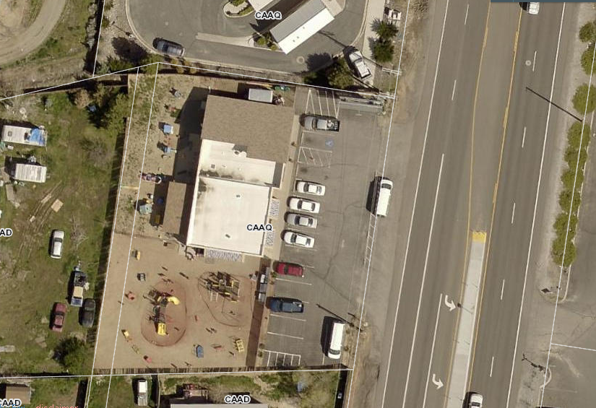
WADMIN20-0005 (ABC Halo)
Washoe County Board of Adjustment
May 7, 2020

Slide 2
Request
This is a request for an administrative permit to allow for the establishment of a child daycare center that will accommodate up to 59 children between the ages of 6 weeks and 12 years old
The subject property has a regulatory zone of Neighborhood Commercial (NC) and Washoe County Development Code (WCC) Table 110.302.05.2 allows child daycare in NC with approval of an administrative permit

Slide 3
Background
Existing 4,596 sf building, parking lot, and playgrounds
Site has been used as a child daycare since December 2011
Administrative Permit (AP11-0004) and Director’s Mod (PF11-09) were approved in 2011
Business license expired over 12 months ago, due to this applicant required to go through AP process again

Slide 4
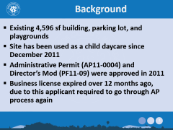
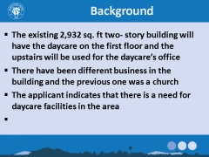
Background
The parking on site will need to meet the current parking requirements, which is 1 off-street parking space for every 8 students and one parking space per employee during peak hours

Slide 5
Public Notice and CAB
Public notice was sent to parcels within 500 feet from the site
The proposed application was not heard at the Sun Valley CAB due to cancellations in response to the Governor’s initiative

Slide 6
Reviewing Agencies
Various agencies reviewed the application, their comments are included in the staff report
Agencies with conditions, are included in the Conditions of Approval

Slide 7
Administrative Permit Findings
Consistency;
Improvements;
Site Suitability;
Issuance Not Detrimental; and
Effect on a Military Installation.
Staff is able to make the required findings, as shown in the staff report on page 7 and recommends approval

Slide 8
Possible Motion
I move that, after giving reasoned consideration to the information contained in the staff report and information received during the public hearing, the Board of Adjustment approve Administrative Permit Case Number WADMIN20-0005 for ABC Halo, having made all five findings in accordance with Washoe County Development Code Section 110.808.25:

